Slide 1
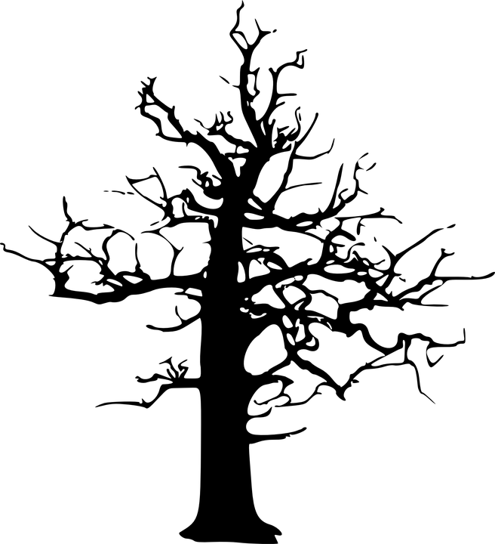
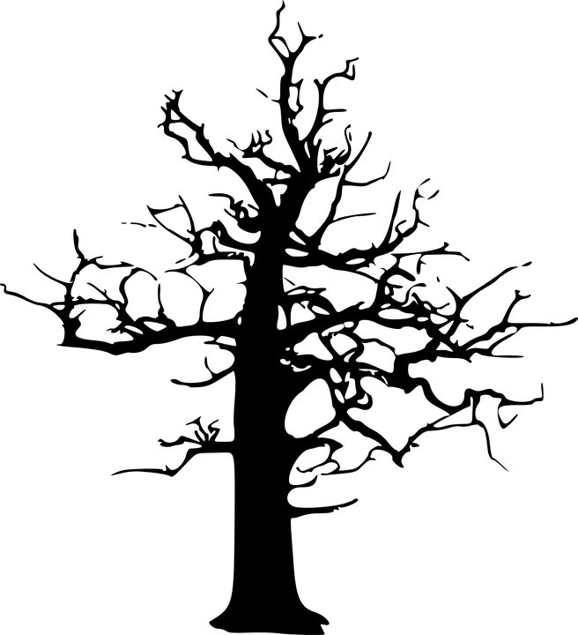
Red-Black Trees
By: Aniah Myles & Antwan Taylor

Slide 2
What is a Red-Black Tree?
A Red-Black Tree is a special binary search tree that keeps itself balanced by using colors (red or black) for each node. This balance helps it stay fast when adding, deleting, or searching for values.

Slide 3
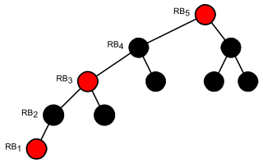
Properties of Red-Black Trees
Node Color: Each node is either red or black.
Root Property: The root of the tree is always black.
Red Property: Red nodes cannot have red children.
- No two consecutive red nodes on the same path.
Black Property: Every path from a node to its descendant null nodes (leaves) has the same number of black nodes.
Leaf Property: All leaves (NIL nodes) are black.
This Photo by Unknown Author is licensed under CC BY-SA

Slide 4
Why Red-Black Trees?
● It keeps data organized and easy to find, even as things change.
● It avoids becoming slow, like a regular binary tree can if it gets too unbalanced.
● If the tree’s height remains O(log n) after every insertion and deletion, then we can guarantee an upper bound of O(log n) for all these operations.
- The height of a Red-Black tree is always O(log n), where n is the number of nodes in the tree.

Slide 5
Basic Operations
Insertion
Search
Deletion
Rotation

Slide 6
Basic Operations
Insertion: Insert the new node like in a standard BST. Then check for violations
Search: Start at the root node. If the target value is less than? Move to the left child. If the target value is greater than? Move to the right child. If the target value is equal? It is found. Repeat until it’s found or NIL is reached.
Deletion: Remove the node using standard BST rules. If a black node is deleted, we must fix the violation.

Slide 7
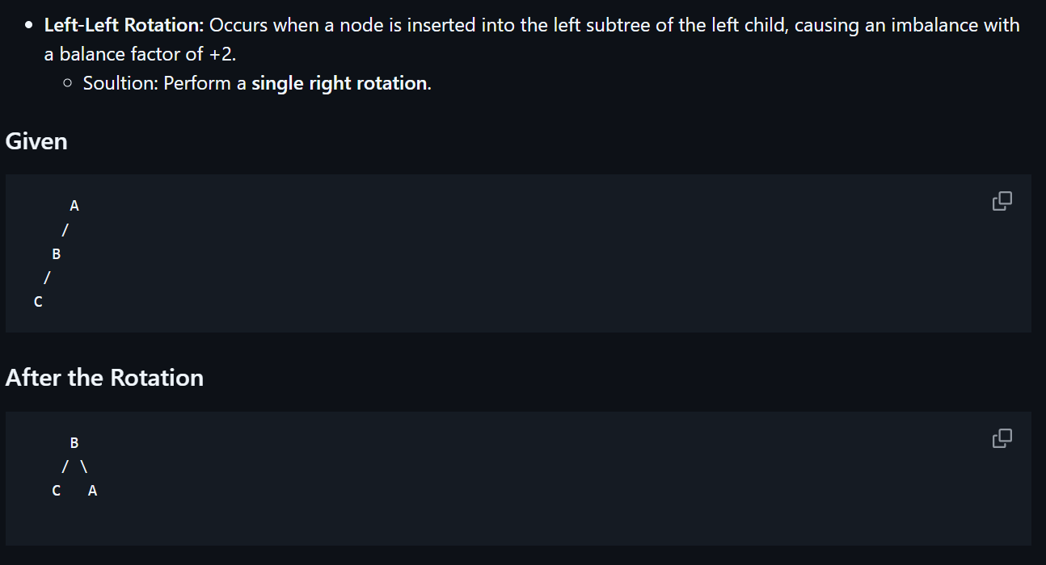
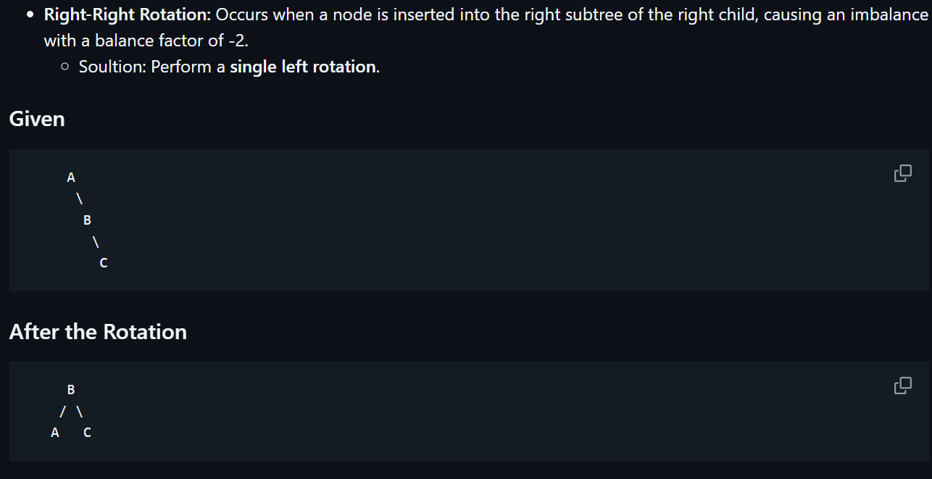
Rotation
Rotations are fundamental operations in maintaining the balanced structure of a Red-Black Tree (RBT). They help to preserve the properties of the tree, ensuring that the longest path from the root to any leaf is no more than twice the length of the shortest path. Rotations come in two types: left rotations and right rotations.

Slide 8
Where do you see it used?
● In Java, Tree Map and TreeSet are used to keep things sorted and easy to find.
● In C++ STL map/set, which also uses red-black trees under the hood.
● In the Linux kernel, they help keep track of processes and memory efficiently.
● In networks, they’re used to manage things like IP addresses or firewall rules.

Slide 9
Why does it matter?
● They stay fast even when data changes a lot.
● They’re more efficient for adding and removing things than some other trees, like AVL Trees
● Red-black trees are a good balance — not too strict, not too loose — which makes them perfect for real-world systems.

Slide 10
Quick Example or Pop Quiz???

Slide 12
What color is the root of the tree?
Black
Red
White

Slide 13
What color is the root of the tree?
Black
Red
White

Slide 14
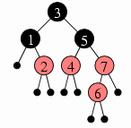
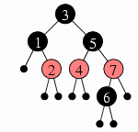
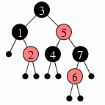
A
Which Red-Black Tree is a valid tree?
A. Tree A
B. Tree B
C. Tree C
B
C

Slide 15
A
Which Red-Black Tree is a valid tree?
A. Tree A
B. Tree B
C. Tree C
B
C

Slide 16
The time complexity for search, insertion, and deletion is O(n log n)?
True
False

Slide 17
The time complexity for search, insertion, and deletion is O(n log n)?
True
False, all are O(log n)

Slide 18
Works Cited
https://www.geeksforgeeks.org/introduction-to-red-black-tree/
https://www.youtube.com/watch?v=qvZGUFHWChY
https://www.youtube.com/watch?v=95s3ndZRGbk
https://www.youtube.com/watch?v=lU99loSvD8s

